Slide 1

Internet law session 5
Dr angela daly 15 November 2019

Slide 2

Welcome back to internet law!

Slide 3
Part i
Privacy and data protection

Slide 4
overview
Privacy
Data protection
Surveillance
Exercises

Slide 5
What are privacy & data protection?
Privacy – the right to be let alone – Warren and Brandeis’ seminar article from 1890
Privacy – as a means of upholding and enhancing our autonomy – Bernal
Data protection as a specific subset of privacy?
See Kokott & Sobotta article
Datafication of everything – can we sensibly talk about privacy and data protection as being distinct anymore?

Slide 6
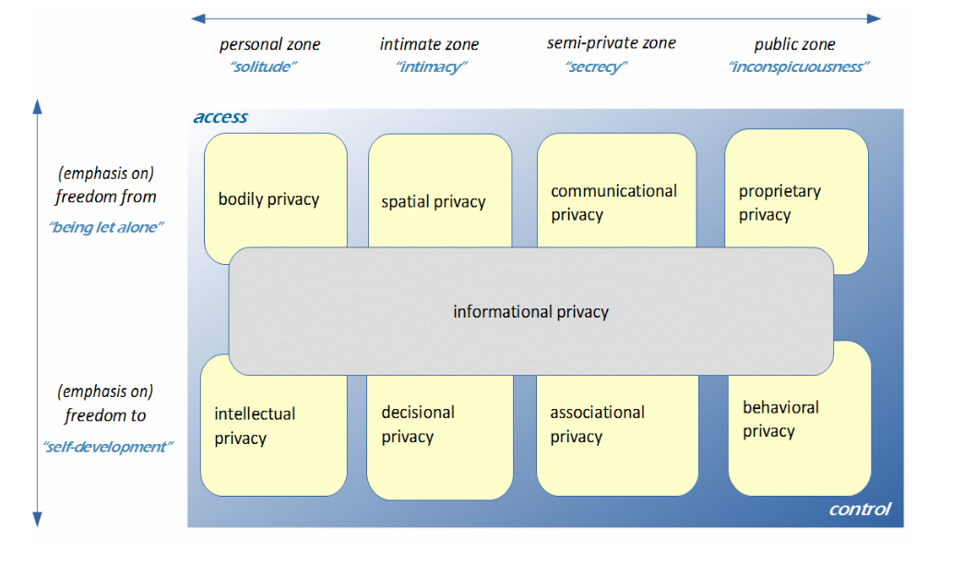
A typology of privacy – koops et al (2017)

Slide 7
Where do we find privacy & data protection laws?
Privacy as a fundamental/constitutional right in many jurisdictions – what about your jurisdiction?
Data protection – usually protected through legislation – but see the EU’s Charter of Fundamental Rights which recognises separate rights to data protection and privacy

Slide 8
European convention of human rights
Article 8
1 Everyone has the right to respect for his private and family life, his home and his correspondence.
2 There shall be no interference by a public authority with the exercise of this right except such as is in accordance with the law and is necessary in a democratic society in the interests of national security, public safety or the economic well being of the country, for the prevention of disorder or crime, for the protection of health or morals, or for the protection of the rights and freedoms of others.

Slide 9
Charter of fundamental rights of the eu
Articolo 7
Rispetto della vita privata e della vita familiare
Ogni persona ha diritto al rispetto della propria vita privata e familiare, del proprio domicilio e delle proprie comunicazioni.
Articolo 8
Protezione dei dati di carattere personale
1. Ogni persona ha diritto alla protezione dei dati di carattere personale che la riguardano.
2. Tali dati devono essere trattati secondo il principio di lealtà, per finalità determinate e in base al consenso della persona interessata o a un altro fondamento legittimo previsto dalla legge. Ogni persona ha il diritto di accedere ai dati raccolti che la riguardano e di ottenerne la rettifica.
3. Il rispetto di tali regole è soggetto al controllo di un'autorità indipendente.

Slide 10
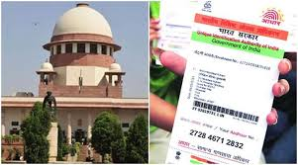
Indian supreme court and privacy

Slide 11
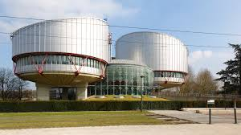
ECtHR case law on privacy
Council of Europe page on Privacy
Guide on Article 8 from the Court
Most recent cases have been on employees’ privacy and workplace surveillance including Lopez Ribalda v Spain from last month; see here for an overview

Slide 12
Data protection

Slide 13
Data protection laws around the world
Over 100 jurisdictions have some kind of data protection legislation – but they vary greatly in levels of protection, sector etc.
DLA Piper map
Origins: OECD Guidelines on the Protection of Privacy and Transborder Flows of Personal Data 1980 (updated in 2013)
Council of Europe Convention for the Protection of Individuals with regard to Automatic Processing of Personal Data 1981 (‘Convention 108’)

Slide 14

Introduction to the gdpr

Slide 15
background
EU’s General Data Protection Regulation:
enacted in 2016, came into force in May 2018
accompanied by Data Protection Law Enforcement Directive
Replaces and repeals previous Data Protection Directive from 1995
In the meantime, data protection also recognised as a human right separate from privacy: Art 8 EU Charter

Slide 16
Data protection as a hybrid & contested area of law
Orla Lynskey: Data protection has a human rights aspect and an economic trade aspect
DPD/GDPR
compromise documents between these two aspects
GDPR itself is a compromise between different interest groups

Slide 17
Also reflected in the gdpr
Article 1 Subject-matter and objectives
1. This Regulation lays down rules relating to the protection of natural persons with regard to the processing of personal data and rules relating to the free movement of personal data.
2. This Regulation protects fundamental rights and freedoms of natural persons and in particular their right to the protection of personal data.
3. The free movement of personal data within the Union shall be neither restricted nor prohibited for reasons connected with the protection of natural persons with regard to the processing of personal data.

Slide 18
Focus of data protection: personal data
GDPR Article 4 Definitions ‘personal data’ means any information relating to an identified or identifiable natural person (‘data subject’); an identifiable natural person is one who can be identified, directly or indirectly, in particular by reference to an identifier such as a name, an identification number, location data, an online identifier or to one or more factors specific to the physical, physiological, genetic, mental, economic, cultural or social identity of that natural person;’ -> very wide/broad definition of ‘personal data’

Slide 19
Art 5 principles related to processing personal data
Lawfulness, fairness and transparency
Purpose limitation
Data minimisation
Accuracy
Storage limitation
Integrity and confidentiality
accountability

Slide 20
Art 6 Lawfulness of processing
6 legal bases on which data processing will be lawful:
  Consent of data subject for one or more specific purposes
  Processing is necessary for the performance of a contract to which the data subject is a party
  Processing is necessary for the data controller’s compliance with a legal obligation
  Processing is necessary to protect the vital interest of the data subject or of another natural person
  Processing is necessary for a task carried out in the public interest or in the exercise of official authority vested in the controller
  Processing is necessary for the purposes of the legitimate interests pursued by the controller or by a third party, except where such interests are overridden by the interests of fundamental rights and freedoms of the data subject which require protection of personal data, in particular where the data subject is a child

Slide 21
Important features of gdpr
Privacy by design (Art 25)
Right to be forgotten (Art 17)
Data portability (Art 20)
Automated decision-making and profiling (Arts 21 & 22)
Active, affirmative consent (Art 7)
Data protection officers (Arts 37-39)
Data breach notification obligations (Art 33)
Much higher fines than before (Art 83)

Slide 22
Extraterritorial research of gdpr
Article 3
Territorial Scope
1. This Regulation applies to the processing of personal data in the context of the activities of an establishment of a controller or a processor in the Union, regardless of whether the processing takes place in the Union or not.
2. This Regulation applies to the processing of personal data of data subjects who are in the Union by a controller or processor not established in the Union, where the processing activities are related to:
The offering of goods or services, irrespective of whether a payment of the data subject is required, to such data subjects in the Union; or
The monitoring of their behavior as far as their behaviour takes place within the Union.
3. This Regulation applies to the processing of personal data by a controller not established in the Union, but in a place where Member State law applies by virtue of public international law.

Slide 23
Gdpr’s worldwide reach - controversial
Through the GDPR’s provisions on its territorial scope and transfers outside of the EU, the reach of the GDPR, according to EU law, the GDPR could apply to many entities and organisations outside of the EU
In my opinion, Art 3 on Territorial Scope was drafted to ensure that large US tech companies such as Google and Facebook, which have millions of users in the EU, would be subject to EU data protection law (in the Costeja case Google argued, unsuccessfully, that it was not subject to EU law)
BUT – in principle any organisation, large or small, in the US or China or a very small country, ought to comply with the GDPR if it is dealing with EU residents’ data in the situations specified in Art 3
Some have criticised the GDPR as the EU’s attempt to regulate the whole internet!
Is this the EU compensating for the fact it does not have a good and strong native technology industry unlike the US and China?

Slide 24

‘Brussels effect’
Process of unilateral regulatory globalisation because of EU de facto externalising its laws outside the borders of the EU
GDPR may be an example of this

Slide 25
What is happening in practice?
Some businesses are adopting GDPR standards globally
Some Governments are aligning their own laws with the GDPR eg Australia might do in its consumer data portability proposal
Partial adoption of the GDPR:
Facebook: only for EU users
Tencent: for users outside China
Refusal to adopt GDPR & exit EU market:
Some US news websites are blocking EU users because the sites do not want to comply with the GDPR

Slide 26

Data protection in the US
Major cultural difference between the US and EU – not the same emphasis on privacy/data protection especially from a human rights perspective
Fourth Amendment in the US offers a degree of privacy against the US government for US citizens
No comprehensive data protection legislation at the federal level in the US
Lots of trans-Atlantic problems over data protection – see CJEU Schrems case, Safe Harbor > Privacy Shield
Since the GDPR has been implemented, California has adopted its own data protect law, the California Consumer Privacy Act 2018, similar to the GDPR
Will other US jurisdictions/federal follow suit?

Slide 27

Questions?

Slide 28


Slide 29
What is surveillance?
The monitoring of behaviour, activities, or other changing information, usually of people for the purposes of influencing/managing/directing/protecting them (Lyon 2007)
Used by govs for intelligence gathering, prevention of crime, protection of process/group/person/object or for investigation of crime
Extent of government surveillance powers go to heart of issues about appropriate role of the state in our lives, including:
  Rule of law
  Liberal democratic
  Public safety and security
  Civil liberties and human rights (especially privacy)
Notes:
https://www.youtube.com/watch?v=9zpdguXIUGQ&list=PL0bO0hb0uPMUZCAqi4PwXhTGJpbg9c8l6&index=3

Slide 30

Surveillance glossary resource
https://www.georgefmchendry.com/key-concepts-in-surveillance-studie

Slide 31
Context
Since 9/11, War on Terror in Western countries has seen expansion of anti-terrorism and law enforcement surveillance powers in many countries
Technological advances:
More people using the Internet
More data being captured by Internet and mobile device use
Lagging laws?
Notes:
https://www.youtube.com/watch?v=RJpmbQTuItE

Slide 32

Private actors
‘economic surveillance’ (Fuchs 2010)
‘Surveillance capitalism’ (Zuboff 2015)
See also:
‘Invisible Handshake’ (Birnhack and Elkin-Koren 2003)

Slide 33
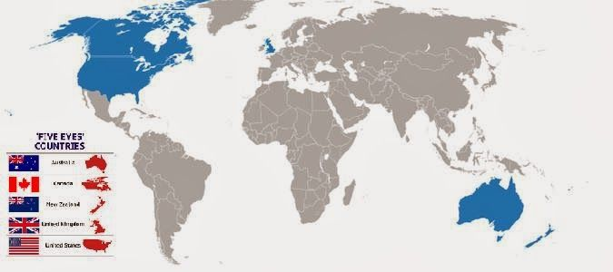
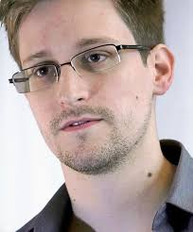
Snowden and Five Eyes

Slide 34
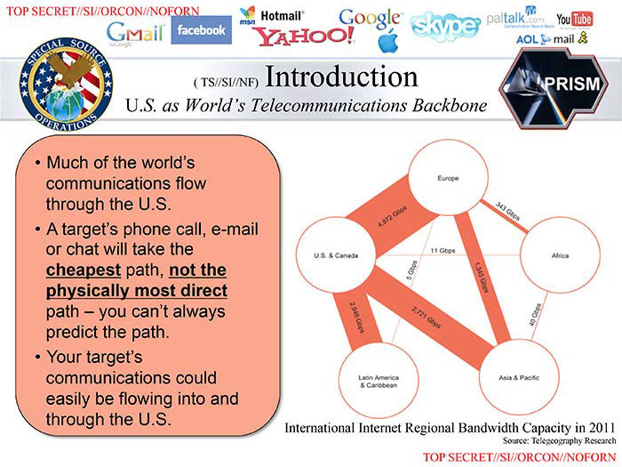
What did snowden reveal exactly?
US NSA mass data collection and monitoring programmes of global Internet communications and other telecoms
Conducted with partner agencies in UK, Australia, Canada, New Zealand (‘Five Eyes’)
Included:
  Monitoring of world leaders’ mobile phones eg Dilma Rousseff, Angela Merkel, Susilo Bambang Yudhoyono
  XKeyscore – Snowden: ‘You could read anyone's email in the world, anybody you've got an email address for. Any website: You can watch traffic to and from it. Any computer that an individual sits at: You can watch it. Any laptop that you're tracking: you can follow it as it moves from place to place throughout the world. It's a one-stop-shop for access to the NSA's information.’
  PRISM – a programme which allows NSA to gather data held by Internet corporations like Google and Yahoo
NSA presentation slides leaked by Snowden

Slide 35
Aftermath
A lot of public criticism about these shadowy mass surveillance programmes
In other Five Eyes countries, these activities were challenged on the basis of infringements to the right to privacy – especially in the European Union e.g. Digital Rights Ireland; Schrems
In the US, the Freedom Act was passed in 2015 to limit the National Security Agency’s bulk data collection
However, in Australia, instead some of these surveillance activities were formally legalised in the passing of data retention legislation – despite similar legislation in the EU being invalidated post-Snowden

Slide 36
Data vs metadata
What is metadata?
False distinction between ‘metadata’ and ‘content data’?
What does ‘metadata’ actually look like?
http://www.zeit.de/datenschutz/malte-spitz-data-retention
Notes:
https://www.youtube.com/watch?v=xP_e56DsymA

Slide 37
Class exercise
Read Digital Rights Ireland CJEU decision (Joined Cases C‑293/12 and C‑594/12)
Answer the following questions:
  What legislation was invalidated in the CJEU’s decision?
  What kind of data did that legislation say could be collected?
  On what basis/bases did the CJEU invalidate the legislation?

Slide 38


Geopolitics of surveillance
Brazil - NetMundial
China vs West: Huawei
https://www.politico.eu/article/5g-telecommunications-infrastructure-china-us-eu-qualcomm-nokia-ericsson-huawei/

Slide 39
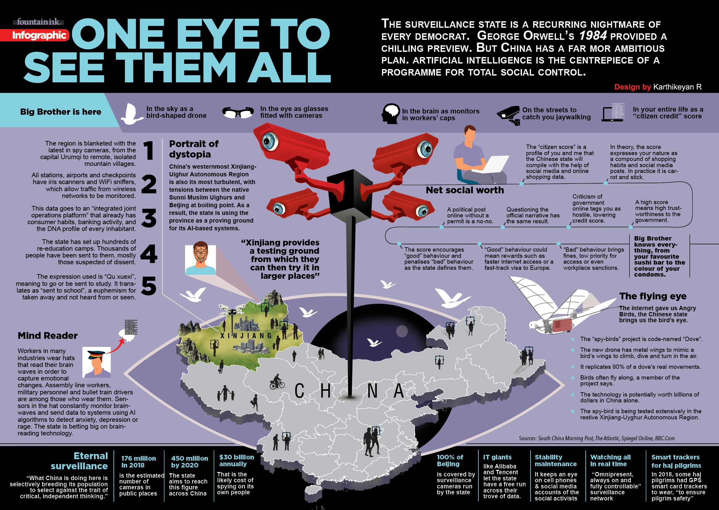

Slide 40
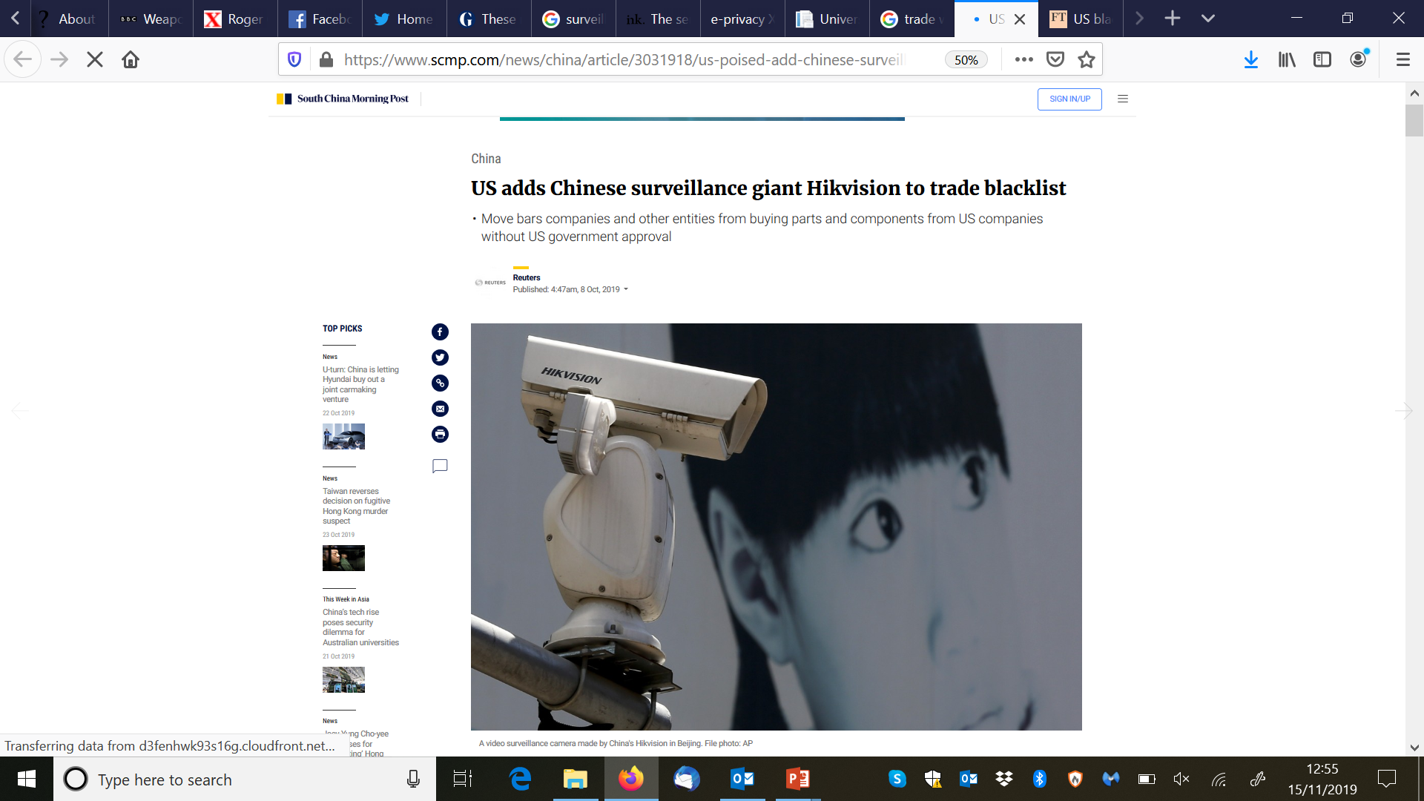

Slide 41
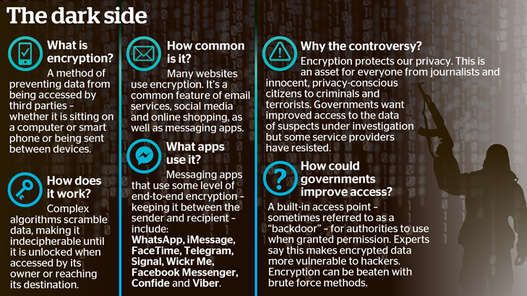
Current issue: encrypted communications

Slide 42
Global political economy of surveillance and export
Watch this film: https://www.bbc.co.uk/news/av/world-middle-east-40531967/weapons-of-mass-surveillance
Who is Ahmed Mansoor? What was he protesting against? What happened to him?
Who is selling surveillance equipment to the United Arab Emirates?
What is EVIDENT?
Which countries is EVIDENT sold to?
Is it legal for the UK government to allow the export of these surveillance tools?
See more: https://www.middleeasteye.net/news/uk-arms-firm-sold-spyware-repressive-middle-east-states
Notes:
Unfair trials and arbitrary detention in the UAE; he was charged with insulting the nation’s leadership. He disappeared and was held in solitary detention.
A Danish company owned by BAE: BAE Systems Applied Intelligence.
Evident = surveillance tool – decryption, voice recognition
Saudi, Qatar, Oman, Morocco, Algeria
UK arms export law: no export licence should be granted if selling equipment would increase risk of breaching international humanitarian law – expert said in his view UK gov was acting illegally in allowing surveillance equipment to be exported to Saudi

Slide 43
In summary
The ‘dark side’ of the Internet and digitisation developments are the huge possibilities for data collection and surveillance by both public and private entities about everyone
We are not clear what the ongoing social impacts of these developments will be
The balance between privacy/autonomy/dignity and security is key to surveillance debates
Ongoing calls for reform/cases esp in EU

Slide 44

Thank You
a.daly@strath.ac.uk

