Slide 1

Internet law session 6
dr angela daly 18 November 2019

Slide 2
cybercrime

Slide 3
What is cybercrime?
https://www.youtube.com/watch?v=AuYNXgO_f3Y

Slide 4
David wall’s categorisations
Cyber-dependent
Cyber-assisted
Cyber-enabled

Slide 5
Cyber dependent crimes
Involve the Internet
But they would still take place if there was no internet
Example given: a murderer searching ‘how to kill someone’ or ‘how to dispose of the body’

Slide 6
Cyber enabled crimes
Created by the Internet
If the Internet is taken away, they will disappear
Examples: DDoS attacks, spamming, digitised IP infringement

Slide 7
Cyber assisted crimes
In-between the other types of crimes
E.g. frauds and deceptions
They are mostly existing crimes in law which have been given a global reach

Slide 8
Objectives and intents of cybercrime - wall
Cybercrimes committed AGAINST the machine: hacking, DDoS attacks
Cybercrimes that USE the machine e.g. fraud
Cybercrimes IN the machine e.g. extreme pornography, hate speech, offensive imagery

Slide 9
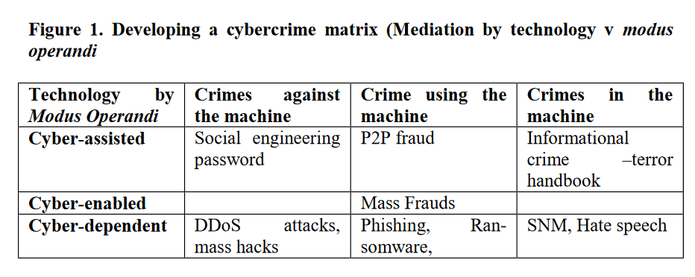
David Wall’s matrix

Slide 10
Laws governing cybercrime

Slide 11
International law – CoE convention on cybercrime
Also known as the ‘Budapest Convention’
Like CoE Treaty 108, various non-CoE-Member States have signed the treaty including: Australia, Canada, Chile, Ghana, Israel, Japan, Mexico, Nigeria, Philippines, South Africa and US
seeks to harmonise national laws on cybercrime, improve investigative techniques and increase cooperation between nations

Slide 12
Convention on cybercrime (continued)
Includes provisions on:
  Definitions
  Substantive crimes ‘against’ computer systems: illegal access, illegal interception, interference, misuse of devices
  Substantive computer-related offences: forgery, fraud
  Content-related offences: child pornography
  Offences related to copyright infringement
  Procedural and investigative powers

Slide 13
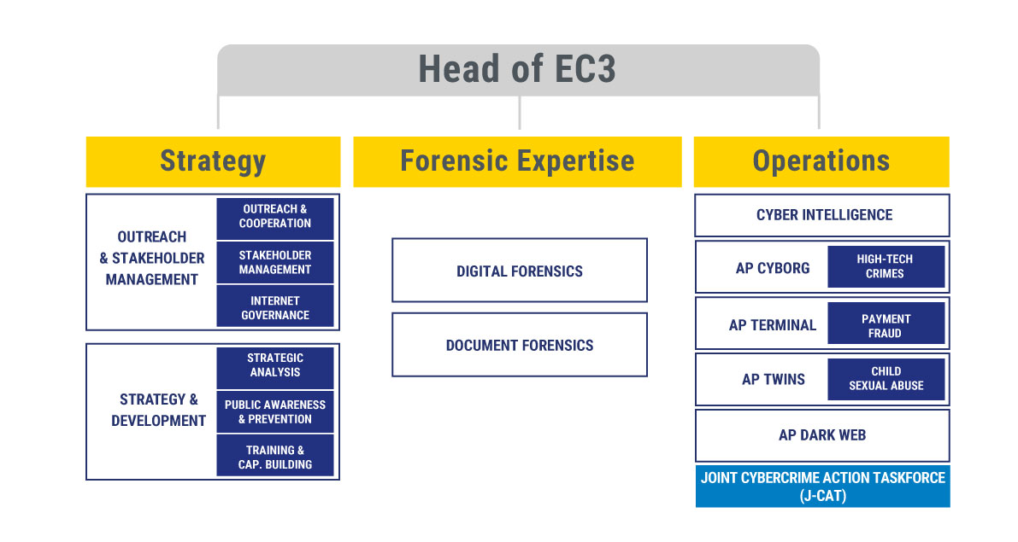
Europol and cybercrime: European cybercrime centre
Notes:
European Union Agency for Law Enforcement Cooperation

Slide 14
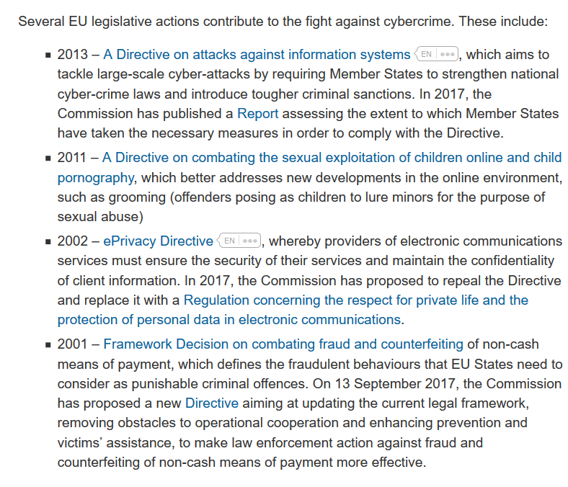
EU cybercrime laws & policies

Slide 15
Major issues for cybercrime

Slide 16
Major issues
Law enforcement access to data
Encryption
Overly broad cybercrime offences

Slide 17

Law enforcement access to data held overseas
Major US case involving data held by Microsoft in its servers in Ireland – did Microsoft US have to hand over the data?
Legal proceedings in US courts
In principle, the US authorities could have used the Mutual Legal Assistance Treaty between US and EU to get this data
Court cases were unresolved; instead US legislature passed the CLOUD Act

Slide 18
Cloud act
‘Clarifying the Lawful Use of Overseas Data Act’ – CLOUD Act – came into force in 2018
2 main effects:
  “The U.S. CLOUD Act allows the U.S. President to enter into “executive agreements” with qualifying foreign governments in order to directly access data held by U.S. technology companies at a lower standard than required by the Constitution of the United States. To qualify, foreign governments would need to be certified by the U.S. Attorney General, and meet certain human rights standards set in the act. Those qualifying governments will have the ability to bypass the legal safeguards of the Mutual Legal Assistance Treaty (MLAT) regime.
  “In addition, U.S. law enforcement agencies (from local police to federal agents) can now compel U.S. and foreign technology[1] companies to disclose communications data of U.S. and foreign users that is stored overseas, regardless of the data’s physical location, potentially bypassing the countries’ privacy and data protection laws.”

Slide 19
EU developments – e-Evidence package
Proposed Regulation and Directive :
  “create a European Production Order: this will allow a judicial authority in one Member State to obtain electronic evidence (such as emails, text or messages in apps, as well as information to identify a perpetrator as a first step) directly from a service provider or its legal representative in another Member State, which will be obliged to respond within 10 days, and within 6 hours in cases of emergency (compared to up to 120 days for the existing European Investigation Order or an average of 10 months for a Mutual Legal Assistance procedure)”
  “create a European Preservation Order: this will allow a judicial authority in one Member State to request that a service provider or its legal representative in another Member State preserves specific data in view of a subsequent request to produce this data via mutual legal assistance, a European Investigation Order or a European Production Order”
Criticism regarding broadness of these proposals and the fact they contribute towards an emerging international trend since the US Cloud Act: https://cdt.org/insights/cdt-recommendations-for-improving-the-european-commissions-e-evidence-proposals/

Slide 20
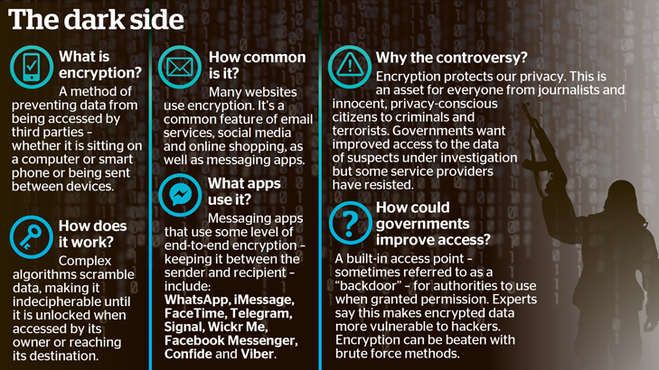
2. encrypted communications

Slide 21
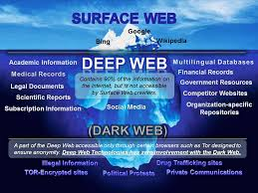
Encryption and the dark web

Slide 22
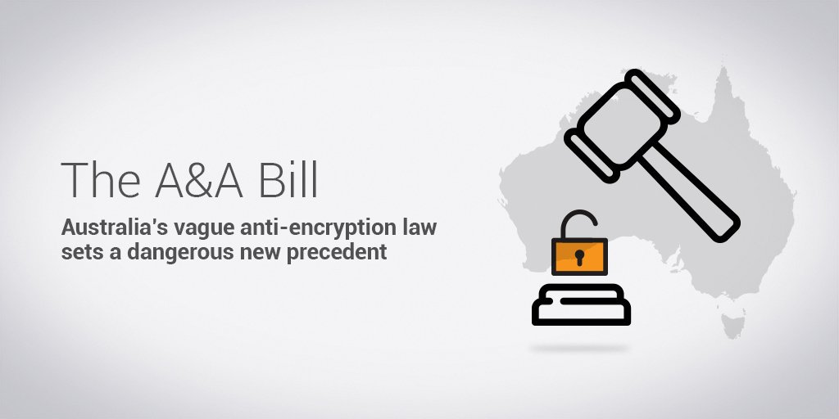
Australian developments

Slide 23
3. Broad cybercrime provisions
Example of Hong Kong: ‘Accessing a computer with criminal or dishonest intent’
S. 161 Crimes Ordinance:
(1) Any person who obtains access to a computer—
with intent to commit an offence;
with a dishonest intent to deceive;
with a view to dishonest gain for himself or another; or
with a dishonest intent to cause loss to another,
whether on the same occasion as he obtains such access or on any future occasion, commits an offence and is liable on conviction upon indictment to imprisonment for 5 years.
(2) For the purposes of subsection (1) gain (獲益) and loss (損失 ) are to be construed as extending not only to gain or loss in money or other property, but as extending to any such gain or loss whether temporary or permanent; and—
(a) gain (獲益) includes a gain by keeping what one has, as well as a gain by getting what one has not; and
(b) loss (損失) includes a loss by not getting what one might get, as well as a loss by parting with what one has.
Penalty: up to 5 years’ imprisonment!

Slide 24
Controversial use of s 161
“The police have invoked the section for “online fraud, illegal intrusion into computer systems, clandestine photo-taking using smartphones in such non-public places as toilets or changing rooms, online publication of obscene or threatening information, as well as inciting others on the Internet to engage in illegal acts.” “
See also:
  use of s 161 regarding online speech encouraging people to participate in Occupy Central protests
  But also use of s 161 in upskirting cases

Slide 25
Hong kong Court of final appeal case
Interpretation of s 161 at issue – Court of Final Appeal case re schoolteachers who had been sharing exam papers among themselves using their smartphones
Issue: “Is the actus reus of the offence under section ‍161(1)(c) of the Crimes Ordinance, Cap 200 (CO) restricted to the unauthorised extraction and use of information from a computer?”
The Court answered: YES

Slide 26
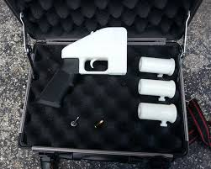

New/emerging issues
3D printing and crime
Cryptocurrencies

Slide 27

Questions?

Slide 28
Thank you!
a.daly@strath.ac.uk

