Slide 1

Internet law session 7
Dr angela daly 18 November 2019

Slide 2

Welcome to the last transnational internet law class!

Slide 3
Future law and technology outlooks

Slide 4
overview
Hyperconvergence
3D printing
Cryptoconvergence
Artificial intelligence

Slide 5
Convergence and regulation

Slide 6
Impact of convergence for regulation
New media and Internet did not fit well into previous laws and policy frameworks
In many countries, there were different government agencies to regulate different kinds of media e.g. one for TV, one for radio, one for movies etc; there would also be a different agency to regulate telecommunications
Which agency/agencies were responsible for regulating the Internet? What laws should they apply? What policy principles should they use?
This was a big question for governments in the 1990s

Slide 7

Future: super/hyperconvergence
Everything is Internet-enabled
What principles of governance and regulation are needed?
Do communications regulators take responsibility for all technologies which are connected to the Internet
Do regulators work with other agencies e.g. financial regulators for bitcoin, or energy regulators for smart grids?
Can ‘communications’ be separated out from all the other digital services and products?

Slide 8
3D printing

Slide 9

How does it work?

Slide 10

What are the problems?
Making dangerous objects
Intellectual property infringement
Guns

Slide 11

Cryptocurrencies

Slide 12

AI, automation, algorithms

Slide 13

background
Development of AI as a transnational digital technology esp by US and China
Proliferation of AI governance/ethics strategies and initiatives from private and public sectors
Lack of international level regulation/law of digital tech
Emergence of a number of geopolitical actors developing and regulating tech – and issuing these strategies and initiatives – Big Jurisdictions, namely: China, Europe(an Union), India, US?
What is happening? Any consensus? Practical implementations of ethics?

Slide 14
What are the risks and legal issues for ai?
Use to administer and enforce the law
Use in ways which are concerning: data protection, discrimination, etc

Slide 15
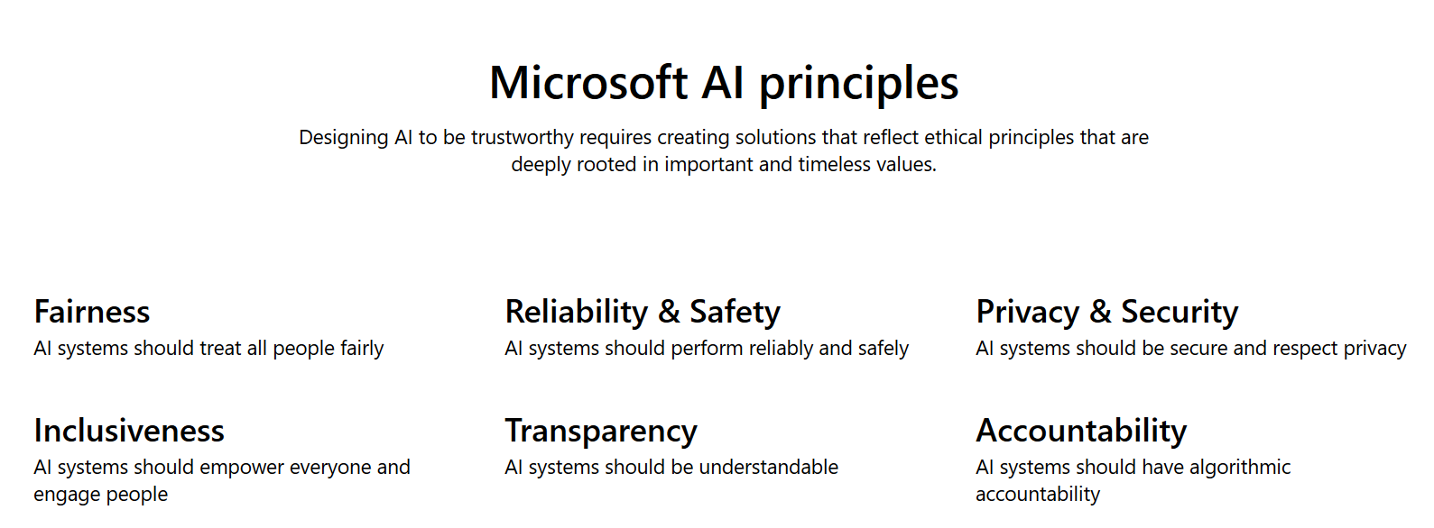
Ai ethics from governments and corporations

Slide 16
International level
No hard law
  An attempt in 2018 to open formal negotiations to reform the UN Convention on Certain Conventional Weapons to govern or prohibit fully autonomous lethal weapons were blocked by inter alia US and Russia – 2018
  UNESCO is working on ‘normative principles’ at the moment
OECD Principles on AI – 2019
G20 ministers agreed on set of principles based on OECD ones – 2019
Technical: IEEE Ethically Aligned Design
Multistakeholder: Partnership on AI

Slide 17
Europe(an Union)
Context: weaker AI industry/development; stronger regulatory impulse – ‘regulatory superpower’?
EU General Data Protection Regulation (GDPR) – came into force in 2018 – binding law; extraterritorial reach; see Articles 21 and 22
European Commission Communication on Artificial Intelligence for Europe; 1 of 3 aims: ensuring ‘an appropriate ethical and legal framework, based on the Union’s values and in line with the Charter of Fundamental Rights of the EU’
European Union High-Level Expert Group on Artificial Intelligence:
  Ethics Guidelines for Trustworthy AI (April 2019)
  Policy and Investment Recommendations for Trustworthy AI (June 2019)
See also: AI strategies and ethics initiatives at Member State level – UK and Germany each want to be the ‘most ethical’ place for AI
See also: Council of Europe activities inc on AI in courts

Slide 18
China
Context: one of the two AI superpowers, along with the US
China’s State Council - The New-Generation AI Development Plan (2017): interim goal, by 2025, is to formulate new laws and regulations, and ethical norms and policies related to AI development in China
the Beijing AI Principles were released by the Beijing Academy of Artificial Intelligence (May 2019) – endorsed by universities and BAT
Artificial Intelligence Industry Alliance (AIIA) Joint Pledge on Self Discipline in the Artificial Intelligence Industry (May 2019)
Expert group of researchers established by the Chinese Government Ministry of Science and Technology released eight Governance Principles for the New Generation Artificial Intelligence: Developing Responsible Artificial Intelligence in June 2019
Private sector; Baidu is member of Partnership on AI and Tencent has its own AI ethics initiatives

Slide 19
United States
Trump Administration Executive Order on Maintaining American Leadership in Artificial Intelligence - February 2019 - American AI Initiative to be guided by five high level principles
  Includes Guidance on Regulation of AI Applications, whereby gov agencies are to receive a memorandum from the Office of Management and Budget within 180 days to inform their regulatory and non-regulatory approaches to AI which ‘advance American innovation while upholding civil liberties, privacy, and American values’
US Department of Defense launched its AI Strategy, also in February 2019:
  ‘will articulate its vision and guiding principles for using AI in a lawful and ethical manner to promote our values’
  ‘continue to share our aims, ethical guidelines, and safety procedures to encourage responsible AI development and use by other nations’.
  A set of principles have been developed and released in Nov 2019

Slide 20
Norms rather than law?
The ethical turn has been criticized by commentators as Wagner (2018) puts it, ‘ethics washing’, for tech companies & governments
Allows tech to sidestep ‘hard’ law including human rights - The political economy of tech entails that human rights (and various other legal requirements) are an afterthought?
See the variety of actors engaged in, and funding ethical AI applications including those which routinely infringe digital human rights!

Slide 21
Geopolitics of ethical and regulatory AI
Tencent’s Chief Exploration Officer David Wallerstein has encouraged the EU and EU companies to focus on ethical applications of AI & leave riskier approaches to US & China
EU emerging as the regulatory power; US and China emerging as the tech and industrial powers on AI?
Most likelihood of AI ethics turning into law in EU compared to other geopolitical heavyweights?

Slide 22
Facial recognition in san francisco
https://www.youtube.com/watch?v=rgyBLU3Syuo
https://www.youtube.com/watch?v=YJVJCz4zJAo

Slide 23
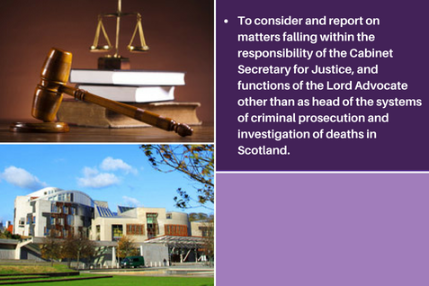
Facial recognition use by police in scotland

Slide 24
Concluding thoughts
Hyperconvergence is bringing the Internet and digital technology everywhere – impact on all areas of law
Emerging technologies are also touching on different areas of law to what I’ve covered in this course
With artificial intelligence, are we seeing international fragmentation of governance? What about the role of China and the EU? Are we moving away from US control?
Will some technologies be banned because they are too inaccurate, problematic, dangerous? San Francisco thinks this is the case for facial recognition

Slide 25

Thank You
a.daly@strath.ac.uk

